Slide 1

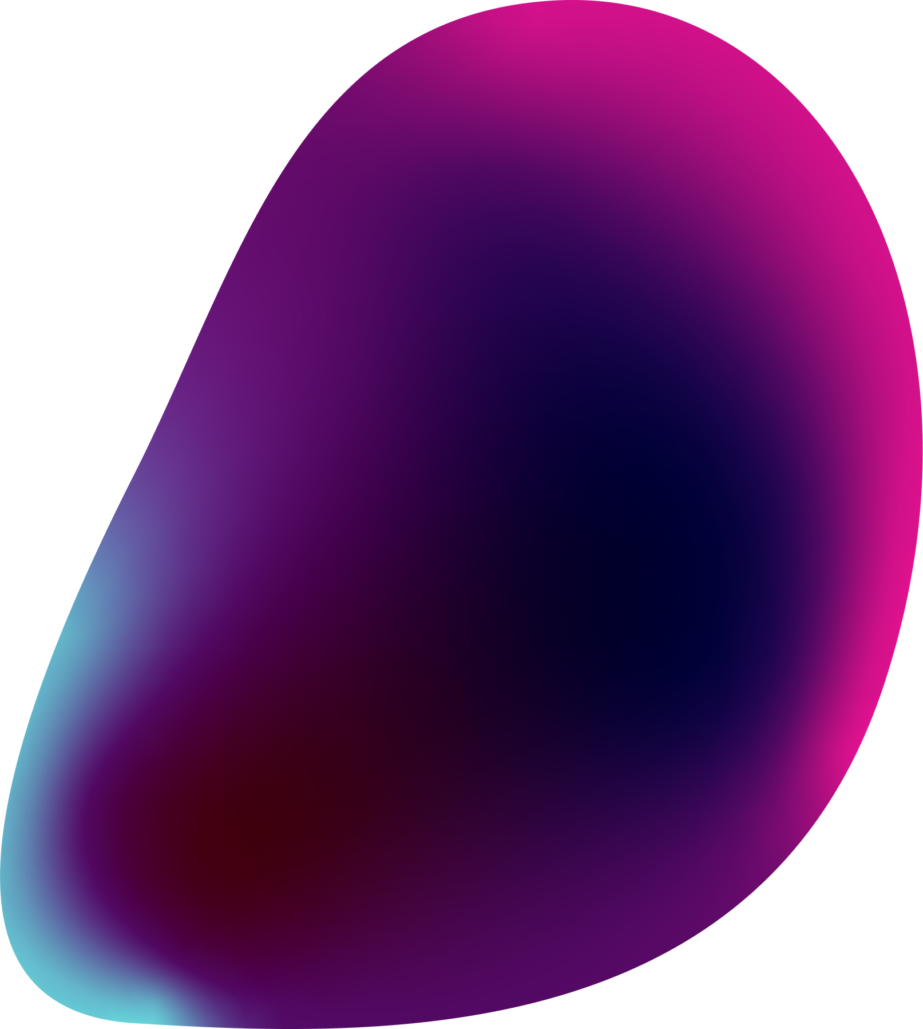

Project Title:
American Sign Language Recognition

Slide 2
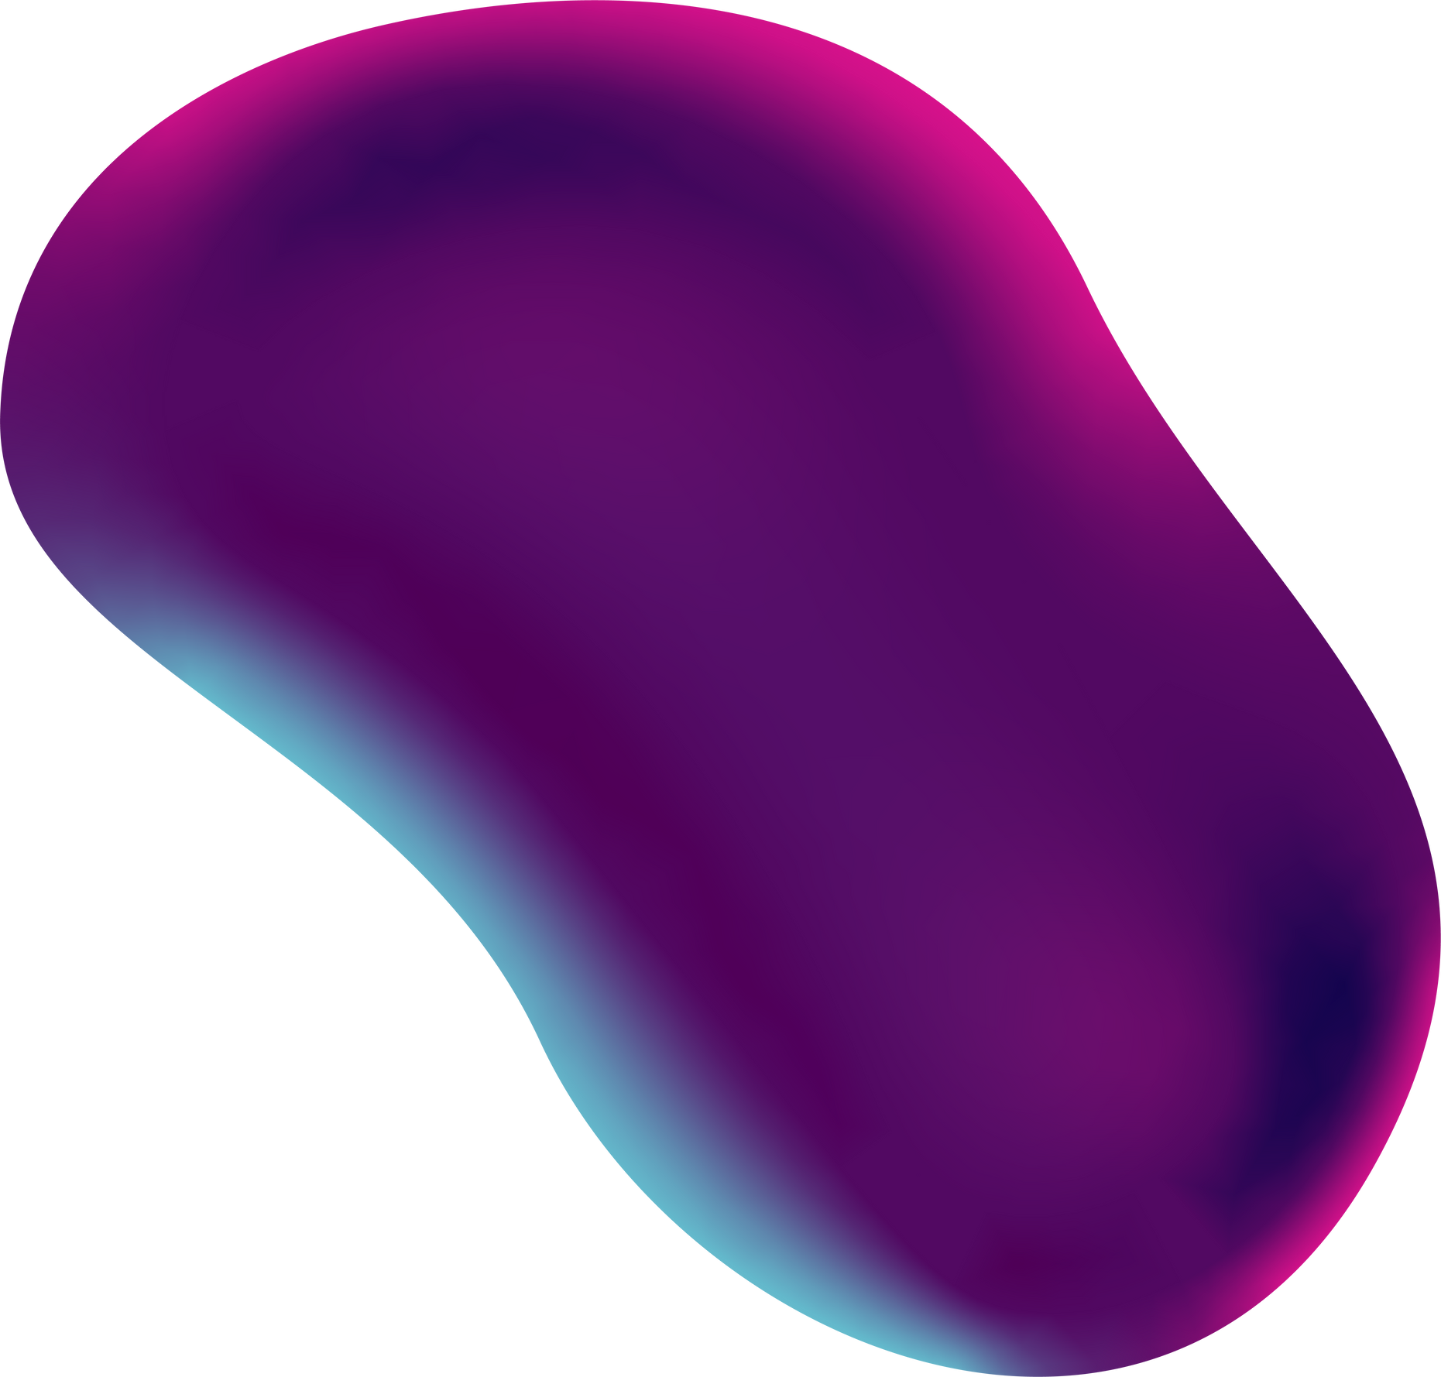
Agenda
1.
PROBLEM STATEMENT
5.
THE WOW IN YOUR SOLUTION
2.
PROJECT OVERVIEW
6.
MODELLING
3.
WHO ARE THE END USERS?
7.
RESULTS
4.
YOUR SOLUTION AND ITS VALUE PROPOSITION
8.
ABOUT ME

Slide 3

01
Problem Statement
To create a machine learning model that will be able to recognize the hand signs from images in the American Sign Language format.
To find a dataset having sufficient images following the ASL format.
To study about Neural Networks and how it can be used.
To split the dataset into training and testing sets.
To learn about Transfer Learning.
To create a model which gives a good accuracy.
To test the model’s accuracy on unseen(test) data

Slide 4
02
Project Overview
In this project, I’ve created a machine learning model that recognizes sign language that is followed by the American Sign Language (ASL) format, from images. The model takes in an image and then predicts which alphabet or number is represented by that gesture. In this way, people who don’t understand Sign Language will be able to understand and interpret them using the machine learning model. Hence, this will gap the bridge of communication that exists in today’s world.

Slide 5
03
Who are the End Users?
This model will isn't restricted to any particular type of users. Anyone who wants to understand and communicate with a pearson who is deaf can use this.
It can be used by all who want to understand the American Sign Language.

Slide 6
YOUR SOLUTION AND ITS VALUE PROPOSITION
04
My main idea here is to create a machine learning model which will recognize and predict the sign from the images and display it, so that the user will understand which alphabet or number is shown in the hand sign gesture. Hence people who have not learned ASL will be able to understand what the other person wants to convey.
I have decided to use InceptionV3 model using the methodology of Transfer Learning to create a model and train it on the ASL dataset obtained.

Slide 7
The model is made using Transfer Learning.
Only a few extra layers were added and it was trained for just 32 epochs, still the model gives an accuracy of 93%.
05
THE WOW IN YOUR SOLUTION

Slide 8
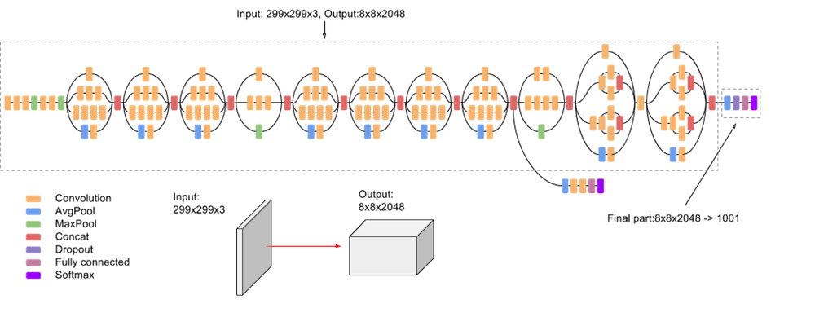
06
MODELLING
InceptionV3 Architecture

Slide 9
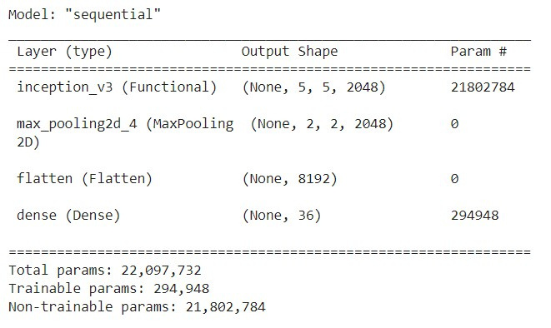
Final Model Architecture

Slide 10
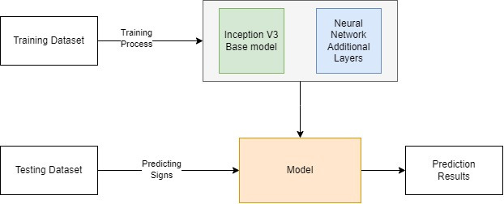
Block Diagram of the System

Slide 11

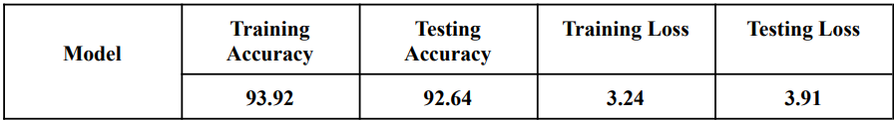
07
RESULTS
I have successfully created a model that can recognize the signs with an accuracy of 93%.

Slide 12
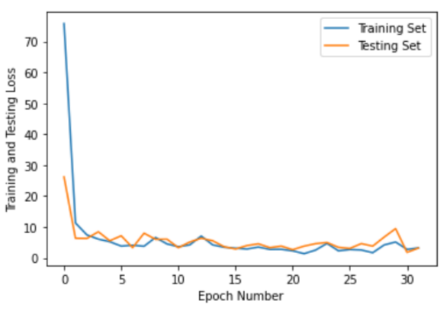
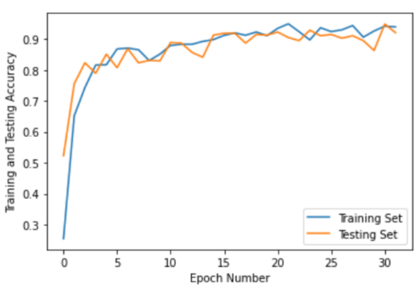
Loss Graph
Accuracy Graph

Slide 13
08
About Me
Greetings,
I'm Valiaparambil Ryan Taffy, a third year Computer Engineering student at Fr. Conceicao Rodrigues College of Engineering.
My main interests are in the domain of AIML and Data Science. I have participated in 2 hackathons under the AIML domain and secured the 2nd place in both of them. I have tried to explore the AIML domain since I find it very interesting as to how machines understand and learn from data.

Slide 14
Thank you

